Slide 1
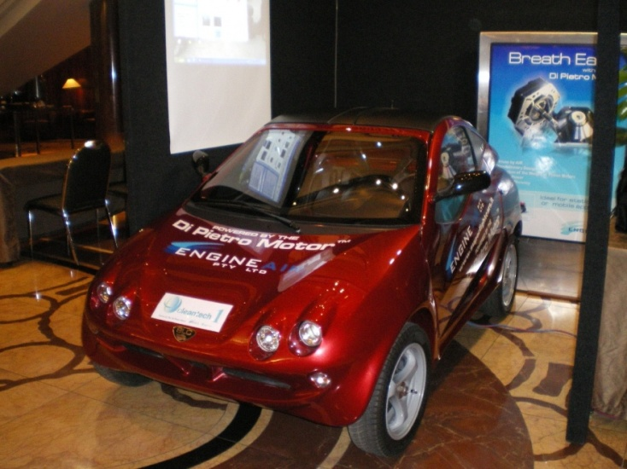
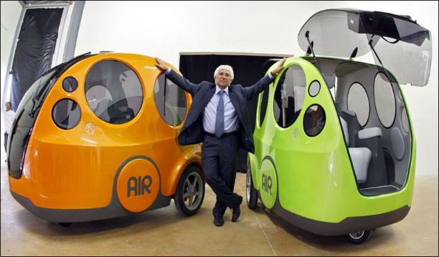
COMPRESSED AIR ENGINE

Slide 2
Introduction
One of the major problems most developing countries facing today is air pollution and the major source of which is automobiles running on road.
Gasoline which has been the main source of fuel for the history of cars. It produces carbon monoxide, Nitrogen oxides and unburned hydrocarbons which are the main pollutants and are responsible for bad effects of pollution.
There comes need to think about alternatives such as Biodiesel and natural gas, Electric cars, Hybrid cars, Hydrogen fuel cells but, these alternative fuels also have some drawbacks.
One possible alternative fuel engine is the compressed air engine.

Slide 3
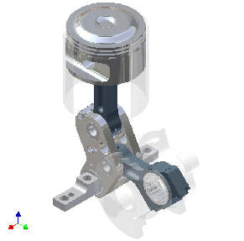
A compressed air engine or Pneumatic motor(air motor) is a type of motor which does mechanical work by expanding compressed air.
It takes compressed air and converts it to energy for mechanical work.
A compressed air engine generally convert the compressed air energy to mechanical work through either linear or rotary motion.
Linear motion can come from either a diaphragm or piston actuator, while rotary motion is supplied by either a vane type air motor or piston air motor.
Reciprocating air engine/ Piston engine

Slide 4
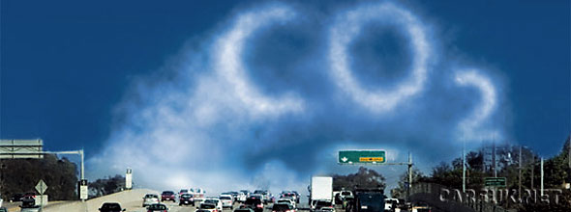

Problems associated with the use of IC
engines
Use of gasoline results in pollution and damage to the environment.
The emission of CO₂ also results in Global Warming.
The fossil fuels are present in limited quantity and are depleting at a very fast pace.
Cost of petroleum products is high.
High maintenance cost involved.
Complexity of design.

Slide 5
Working of a C.A.E.
It works only with two strokes that is a intake/compression stroke and a exhaust stroke/power stroke which requires two piston movement (one cycle) in order to generate power.

Slide 6
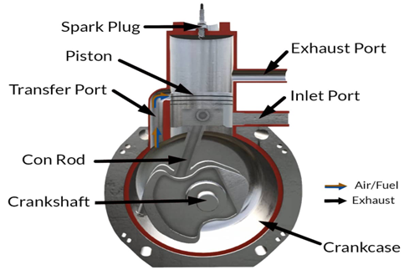
The engine is able do produce power after one cycle because the exhaust and intake of the gas occurs simultaneously. There is a valve for the intake stroke that opens and closes due to changing pressures. In addition, due to its frequent contact with moving components, the fuel is mixed with oil to add lubrication, allowing smoother strokes.
Compression stroke: The inlet port opens, the air-fuel mixture enters the chamber and the piston moves upwards compressing this mixture. A spark plug ignites the compressed fuel and begins the power stroke.
Power stroke: The heated gas exerts high pressure on the piston, the piston moves downward (expansion), waste heat is exhausted.

Slide 7
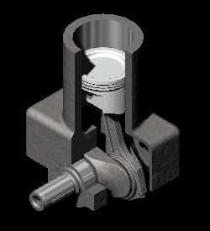
Compression stroke

Slide 8
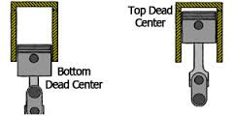
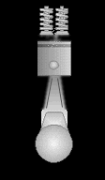
Stroke 2/ power stroke/exhaust stroke

Slide 9
Operation of Compressed Air Powered Engine
Compression Stroke
The piston moves from TDC (Top-Dead-Centre) to BDC (Bottom-Dead-Centre) letting the fresh air enter the combustion chamber. The fresh air-fuel mixture gets into the combustion chamber through the crankcase. In this stroke, the crankshaft makes the rotation of 180⁰.
Exhaust Stroke
The piston is pushed from BDC to TDC. As a result, the fuel-air mixture gets compressed and the spark plug ignites the mixture. The mixture expands and the piston is pushed down. The inlet port is open during the upstroke. While the inlet port is opened, the mixture gets sucked inside the crankcase. When the mixture is pushed up into the combustion chamber during the previous upstroke, a partial vacuum is created as no mixture is left behind in the crankcase. This mixture is ready to go into the combustion chamber during downstroke but remains in the crankcase until the piston goes up to TDC. In this stroke, the crankshaft makes the rotation of 180⁰.
From the 2nd downstroke onwards the exhaust gases get expelled out from one side while a fresh mixture enters into the combustion chamber simultaneously due to a partial vacuum created in the combustion chamber after the removal of exhaust gases. This is the beauty of the engine. Both things happen at the same time which makes it a 2-stroke engine.

Slide 10
Building Compressed Air Engine From Conventional Engine.
Valve timing.
Alterations in Camshafts.

Slide 11
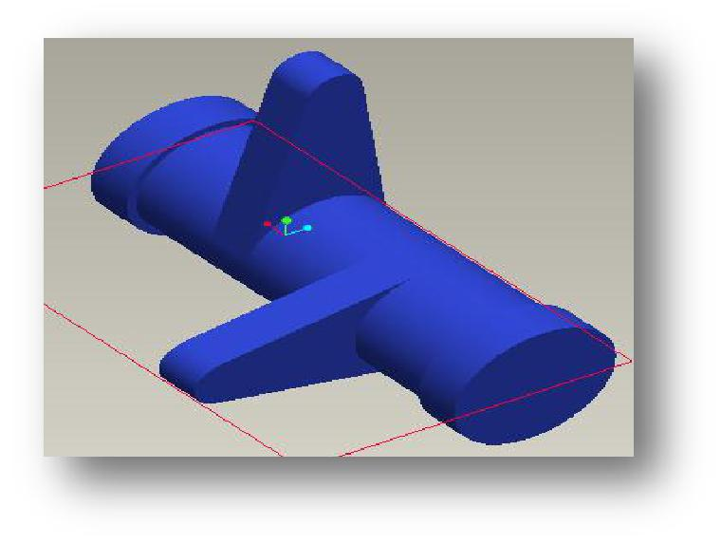
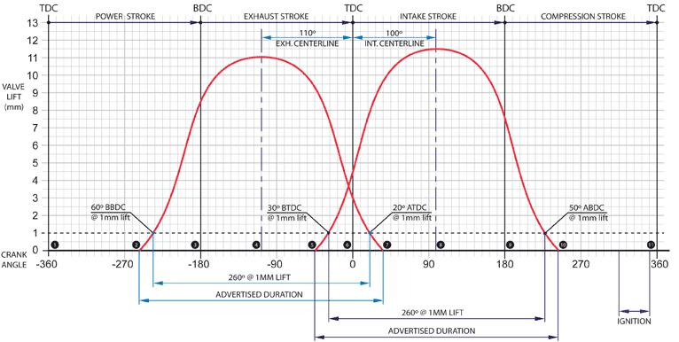
Alterations in Camshafts.
Design of a 4-stroke
S.I engine cam shaft.
Valve timing diagram.
`

Slide 12
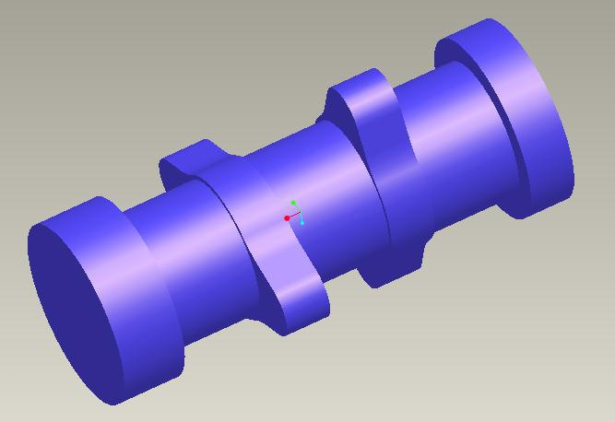
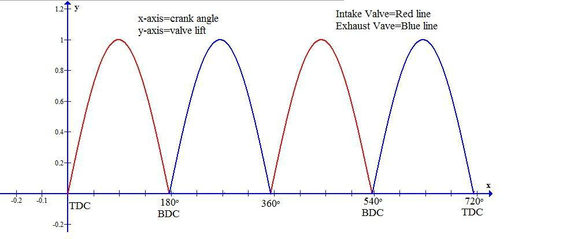
Modification in the cam.
Design of a compressed
Air engine cam shaft.
Valve timing diagram.

Slide 13
Modification of engine
Original design of engine
Modified design of engine

Slide 14
Performance
Maximum speed: 60 mph
Acceleration times: 0-30 mph in less than
3 seconds.
Weight: 1543 lbs.
Light weight provides Good road-holding due to low center of gravity and low energy consumption.

Slide 15
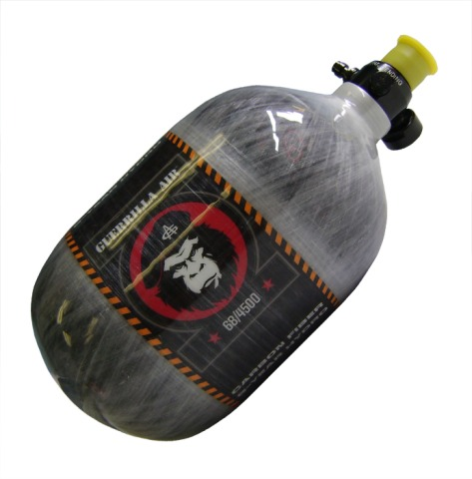
COMPRESSED AIR TANK
Located underneath the vehicle
Made of carbon fibers. Hence safe to risk of explosion
Holds 90 cubic meters of air,
compressed to 300 bars.
These tanks do not explode in case of accidents since there are no metals in them.

Slide 16
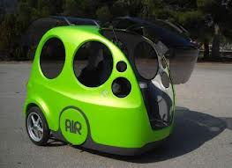
BODY OF THE CAR
Its body is made up
of FIBER GLASS and
INJECTED FOAM.
It is slightly costly ,
but it does not cut
like steel.
It does not rust.
It is light weighted.

Slide 17

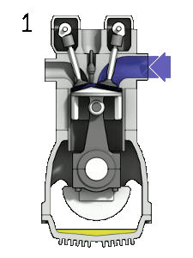
WORKING
Suction
Compression
Expansion
Exhaust

Slide 18
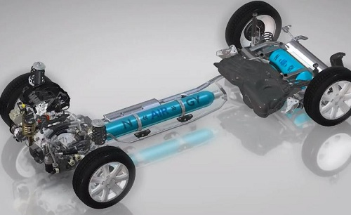
THE CHASSIS:
Engine has put together highly-resistant, yet light, chassis, aluminum rods glued together
Aluminum rods enables to build more shock resistant chassis than regular chassis.
The rods are glued the same way as aircraft
This system helps to reduce manufacture time.
Allow quick assembly

Slide 19
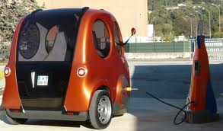
CHARGING METHODOLOGY
The recharging of the car
will be done at gas stations,
and takes about to 2 to 3
minutes at a price of 135
rupees. After refilling, the
car will be ready to drive
200 kilometers.
Charging station of CAV

Slide 20
ADVANTAGES
The vehicle can be plugged in to a residential electrical outlet and charged at home.
The cost of parts and labor to build the vehicle should be lower because there is no cooling system, spark plugs, starter motor, or mufflers.
As air expands it cools and this can be utilized for a compressed air vehicle air conditioning system.
The vehicle truly emits zero emissions at the place where it is operating.
Some compressed air vehicles can capture energy during braking, increasing range and efficiency.
The use of compressed air vehicles reduces the dependence on foreign oil.

Slide 21
.
Disadvantages
Less power output.
To improve efficiency of a compressed air vehicle a “heating” system is required.
When a compressed air storage tank is filled, heat energy is released. If the energy is not dissipated the temperature of the tanks will rise.
Charging the compressed air tank will take around 3 hrs when the compressor is powered by a residential wall plug.
Probability of leakage of air.

Slide 22
COMPARISON WITH ELECTRICAL VEHICLE’S
SPECIFICATION | 2000 Nissan altra EV | 2001 Toyota Rav 4EV | C.A.V.
FUEL TYPE | Electric. | Electric. | Compressed air.
MPG AVG | 123 | 104 | 198
FUEL cost | $331.00 | $391.00 | $212.00
TOP SPEED | 75 MPH | 78 MPH | 60 MPH
RECHARGE TIME | 5 Hours | 6.3 Hours | 3-4 min.
PRICE | $10,000 | $9,4000 | $3,4000

Slide 23
DUAL ENERGY MODE
SINGLE ENERGY MODE
It uses only compressed air as fuel
It runs completely on compressed air
It causes less pollution
Has a maximum speed of 110km/h.
DUAL ENERGY MODE
It uses compressed air and also fossil fuels as fuel
At over 50km/hr engine will switch to fuel mode
It causes more pollution

Slide 24
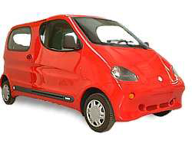
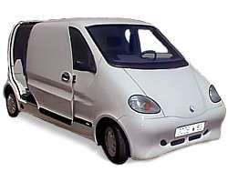
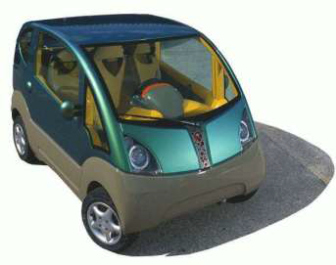
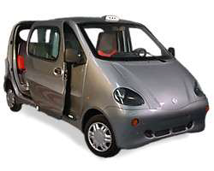
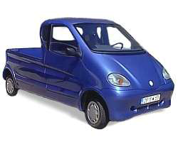
Applications
1. Family
Cars
2. Vans
3. Taxis
4. Pick-Ups
5. Mini-Cats

Slide 25
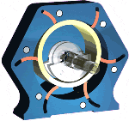
Current research
EngineAir
EngineAir, an Australian company, is making a rotary engine powered by compressed air, called The Di Pietro motor.
The Di Pietro motor concept is based on a rotary piston
the Di Pietro motor uses a simple cylindrical rotary piston (shaft driver) which rolls, with little friction, inside the cylindrical stator. It can be used in boat, cars, burden carriers and other vehicles.
Energine
The Energine Corporation was a South Korean company that claimed to deliver fully assembled cars running on a hybrid compressed air and electric engine.
Di Pietro motor.

Slide 26
Conclusion
The air powered cars are the best options which provide most
comprehensive answer to the present urban pollution problems in simple,
economic and inoffensive manner.
These are clean, easy to drive, comparatively low cost and does not take a life time to pay off.
Thus these vehicles are safe to manufacture, safe to use, safe to users and also
environment friendly.

Slide 27
IN THE CASE OF SOLAR PANELS
power production occurs during daylight hours, which typically occurs when residents are not drawing a big electrical load because much of the household is not at home. Conversely, during nighttime hours, when lights are on and residents are in general using more electricity, the solar panels are sitting idle. Thus, without appropriate energy storage methods, excess power generation cannot be saved for later use. Compressed air energy storage (CAES) plants offer one solution to this obstacle with the ability to convert off-peak reduced-cost grid electricity (or any form of renewable energy with an inherently variable output) to stored energy in the form of high-pressure air. When electricity demand signal grows, this compressed air can be converted back to electricity by an expansion device.

Slide 28
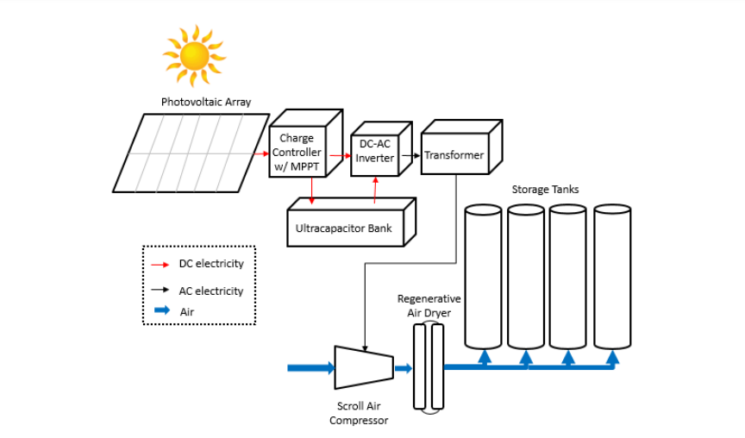
Block diagram

Slide 29
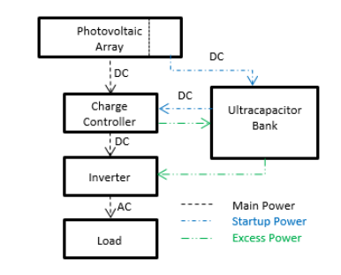
The micro grid that powers the compressed air system consists of a PV array, ultracapacitors, a maximum power point tracking (MPPT) controller, and a DC-to-AC inverter Solar radiance is converted to electrical energy by a PV array, MPPT charge controller, optimizes the PV array’s variable DC voltage output, continuously maximizing the PV array’s power output, the MPPT circuit also maximizes available loading amperage, invertor converts the electrical current from DC to AC and sends power to the load.

Slide 30
Startup Power and Excess Storage
Startup power is supplied by and excess energy storage is stored in a bank of ultracapacitors. Portion of the PV array charge the ultracapacitor bank until voltage builds up to provide startup power to the Solar charge controller. After the charge controller starts, it uses MPPT to fully charge the ultracapacitor bank with the remaining panels. Following this startup operation, the ultracapacitors store surplus energy when the PV array is producing power in excess of load requirements.

